Slide 1
OC - Project 6
Automatic classification
of
consumer goods
Ecommerce “Place de marché” EDA
for Machine Learning
Stephane Lanchec, Jan 2022

Slide 2
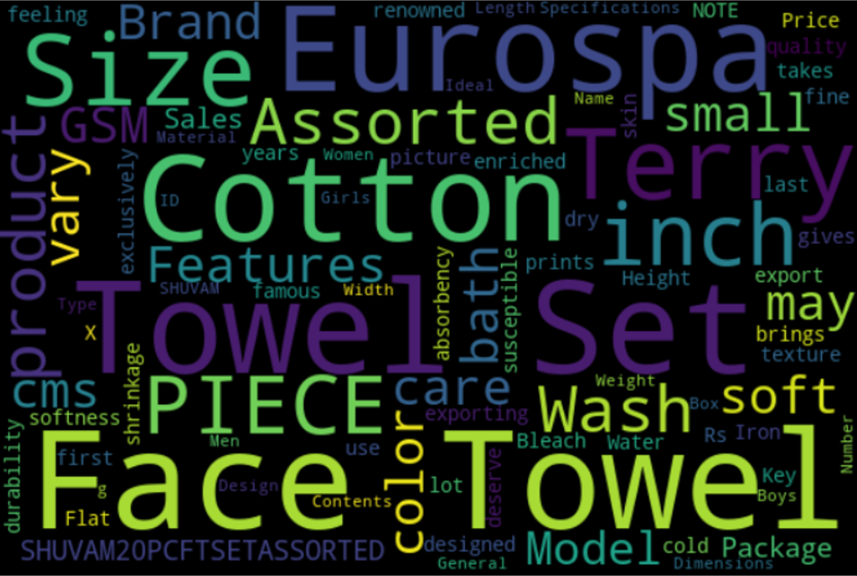
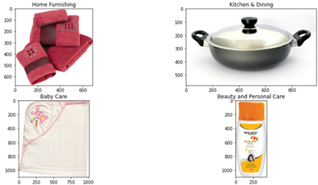

Background
E-commerce ‘Place du Marche’ launch
Sellers to buyers transactions business through display of articles (Image & text)
Items for sale manually input in database as per now
Objective
Feasibility study of a classification engine for consumer goods
Replace manual input of items by an automatic classification process
How?
Dataset of 1050 item images and associated texts
Unsupervised classification through Image, text and both combined

Slide 3
Process Workflow
Processing
Feature extraction
Dimension reduction
Unsupervised classification
Evaluation
YES
Words Embedding
Topic Modeling
Text
Evaluation
Performance
Comparison
Sentence Transformer
NO
PCA
T-SNE
Input Data
Kmeans clustering
SIFT
YES
Image
CNN
NO

Slide 4
Text Process overview
Phase 1
Phase 2
Phase 3
Data Preparation
Pre-processing
Words embedding
Count Vectorizer
Hashing Vectorizer
Tf-idf Vectorizer
Sentence Transformer
USE
Paraphrase-multilingual
MPNET
Dimensionality reduction
LDA
NMF
PCA
T-SNE
Clustering
KMeans
Topic
modeling
Model Evaluation
Clusters distribution
Adapted metrics
Methods comparison
TEXT
RAW
4

Slide 5
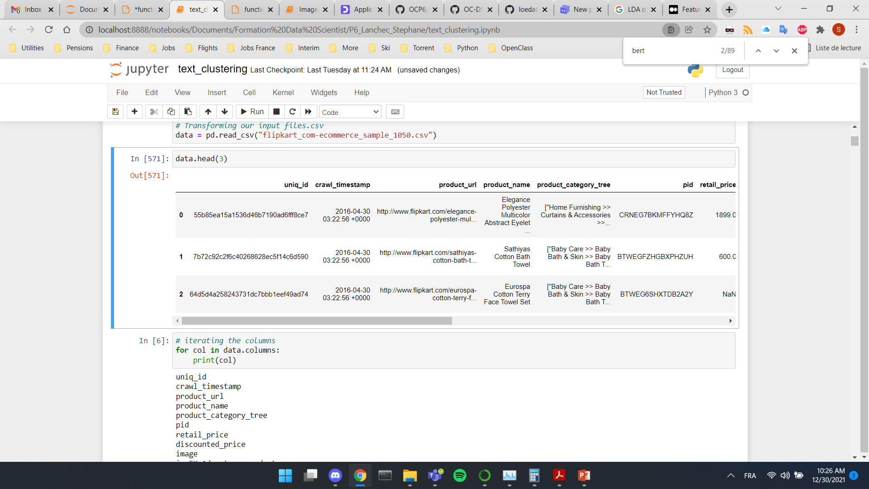
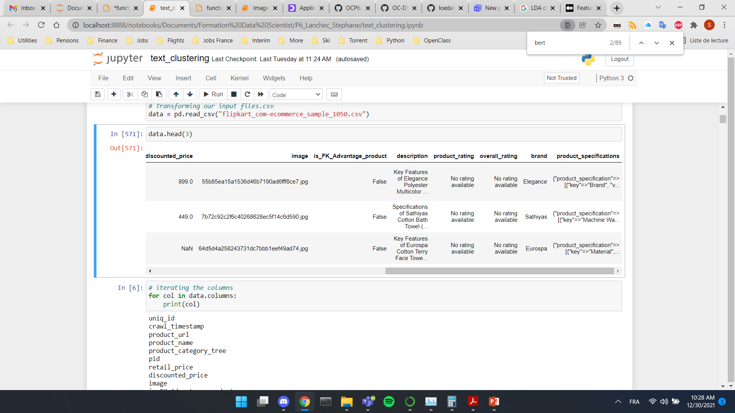
Dataset overview
1050 rows × 15 columns
Dataset columns
Focus on 3 columns for text processing
Product_category_tree
Description (desc)
Product_specifications
(prod_spec)
uniq_id
crawl_timestamp
product_url
product_name
product_category_tree
pid
retail_price
discounted_price
image
is_FK_Advantage_product
description
product_rating
overall_rating
brand
product_specifications
["Kitchen & Dining >> Lighting >> Bulbs >> BFT Bulbs >> BFT 6 W LED Bulb (White)"]
Key Features of BFT 6 W LED Bulb Pack of 1 Bulb,BFT 6 W LED Bulb (White) Price: Rs. 350 Introducing new technology in led lighting LED filament. Pack of 1
+
{"product_specification"=>[{"key"=>"Brand", "value"=>"BFT"}, {"key"=>"Model Number", "value"=>"BFTCW6"}, {"key"=>"Material", "value"=>"Glass"}, {"key"=>"Bulb Base", "value"=>"B22"}, {"key"=>"Light Color", "value"=>"White
(desc_spec)

Slide 6
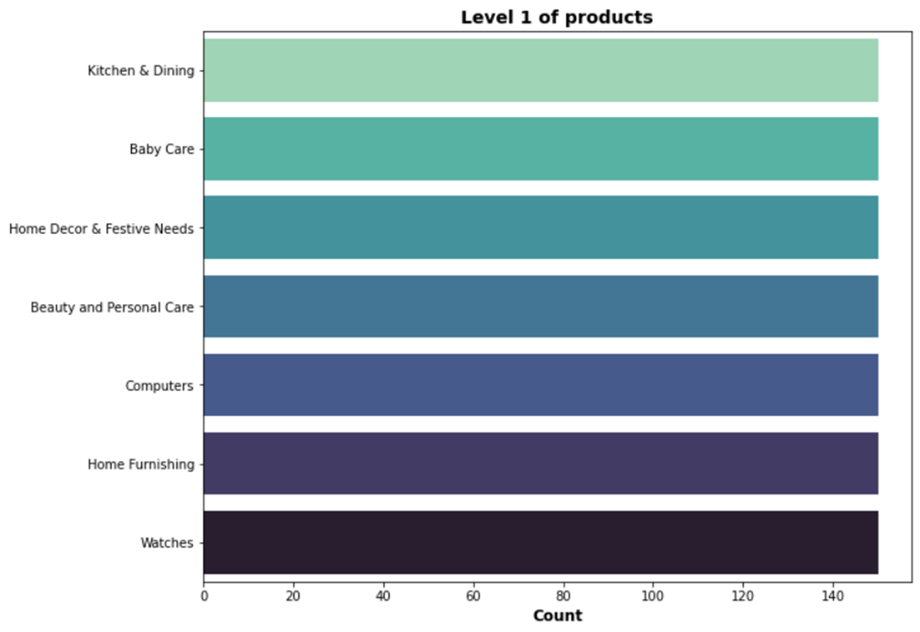
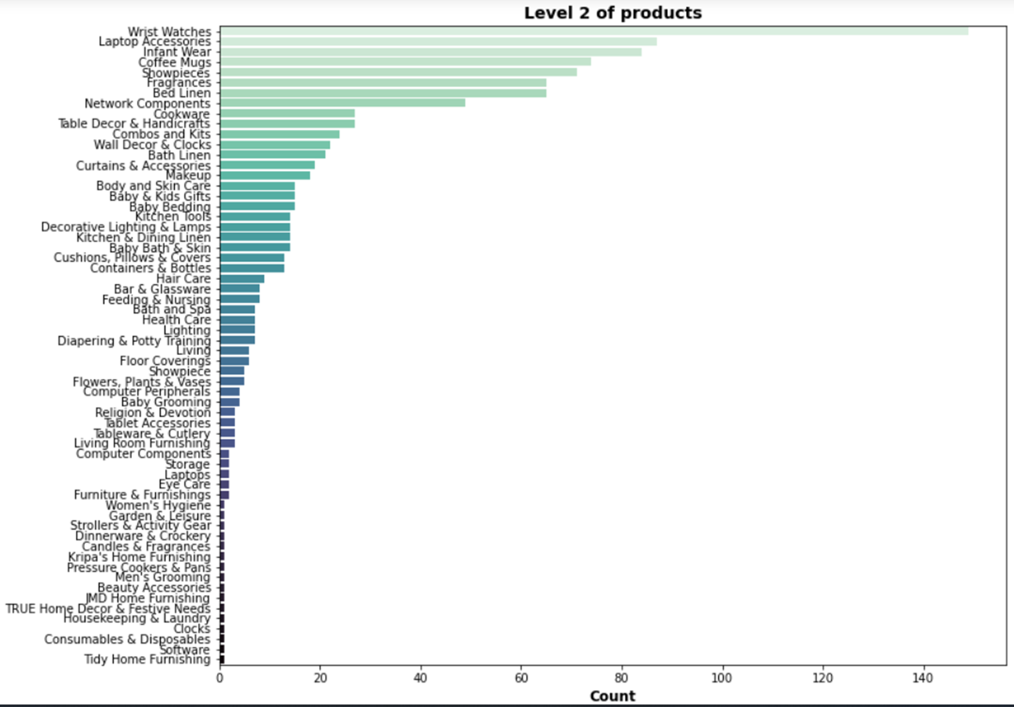


Product categories
7 categories Level 1: 150 products
Homogeneous distribution
62 categories Level 2: x products

Slide 7
Text Preprocessing*
* Applied on both « description » & « product_specifications » section
Original Text Exemple
Key Features of Eurospa Cotton Terry Face Towels Set Size: small Height: 9 inch GSM: 360,
1 -
Tokenization - Split of text into lexical units
'Key', 'Features', 'of', 'Eurospa', 'Cotton', 'Terry', 'Face', 'Towels', 'Set', 'Size', ':', 'small', 'Height', ':', '9', 'inch', 'GSM', ':', '360', ','
2 -
Lower case conversion
'key', 'features', 'of', 'eurospa', 'cotton', 'terry', 'face', 'towels', 'set', 'size', ':', 'small', 'height', ':', '9', 'inch', 'gsm', ':', '360', ','
3 -
Punctuation removal
'key', 'features', 'of', 'eurospa', 'cotton', 'terry', 'face', 'towels', 'set', 'size', '', 'small', 'height', '', '9', 'inch', 'gsm', '', '360', ''
4 -
Non-alphabetic characters removal
'key', 'features', 'of', 'eurospa', 'cotton', 'terry', 'face', 'towels', 'set', 'size', 'small', 'height', 'inch', 'gsm'
5 -
Stopwords removal
'key', 'features', 'eurospa', 'cotton', 'terry', 'face', 'towels', 'set', 'size', 'small', 'height', 'inch', 'gsm'
6 -
Lemmatization - process of grouping together the inflected forms of a word so they can be analysed as a single item
'key', 'feature', 'eurospa', 'cotton', 'terry', 'face', 'towel', 'set', 'size', 'small', 'height', 'inch', 'gsm'

Slide 8
Words & texts embedding
CLASSIC MODELS
PRE-TRAINED MODELS
Count Vectorizer
Converts a collection of text documents to a matrix of token counts
Hashing Vectorizer
Does not store the vocabulary
Tf-idf Vectorizer(Term Frequency Inverse Document Frequency)
Focuses on the frequency of words present in the corpus but also provides the importance of the words
Universal Sentence Encoder (USE)
Encodes text into high dimensional vectors
paraphrase-multilingual
Maps sentences & paragraphs to a 384 dimensional dense vector space (BERT architecture)
MPNet
Masked and Permuted Pre-training for Language Understanding
Raw data
Preprocessed data

Slide 9
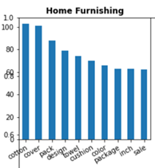
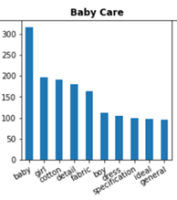
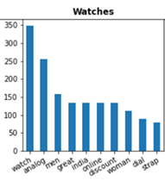
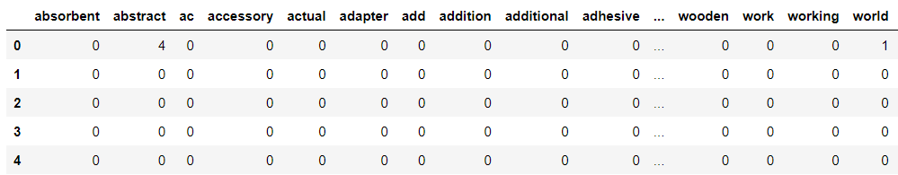
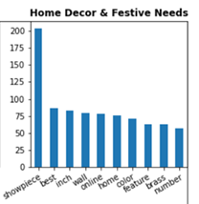
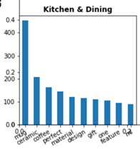
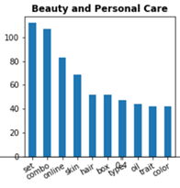
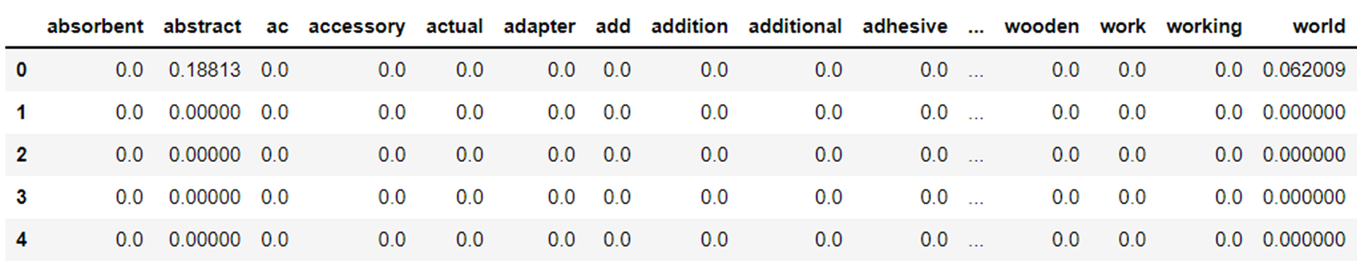
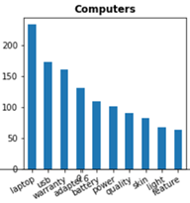
Converting text data into vectors
CountVectorizer (Matrix of token counts)
10 most recurrent words per category
5 rows × 926 columns
Tf-idf (Frequency of words)
5 rows × 926 columns

Slide 10
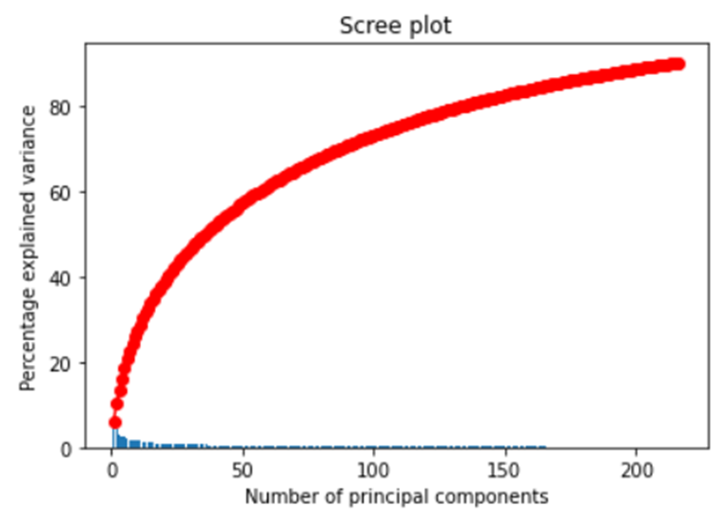
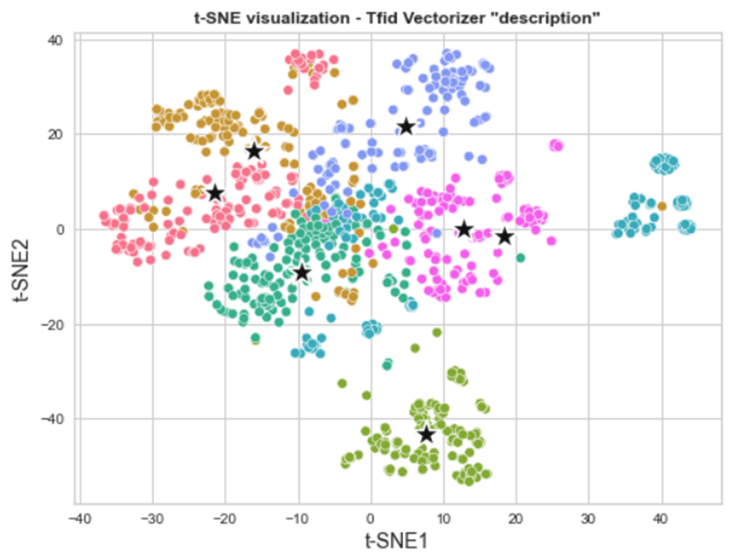
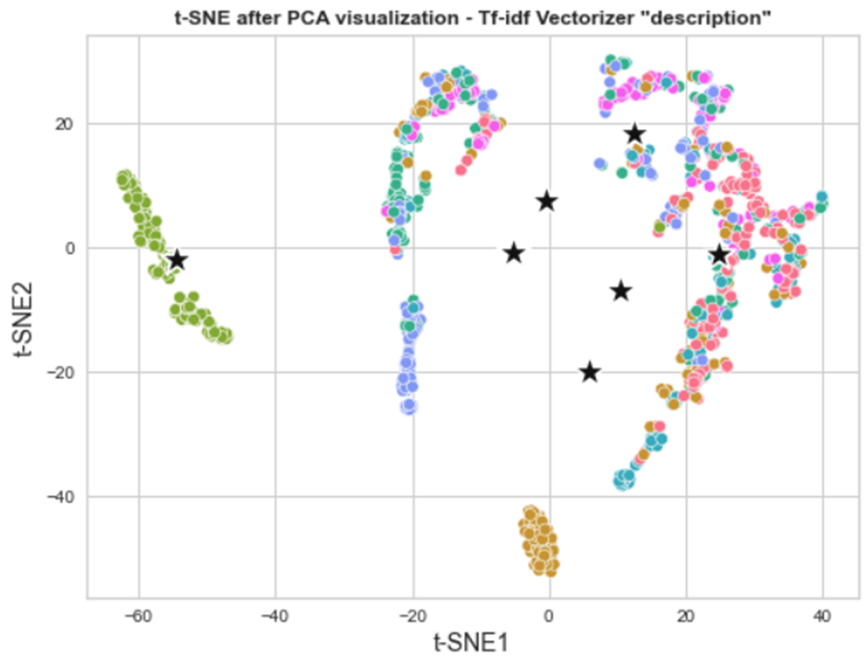
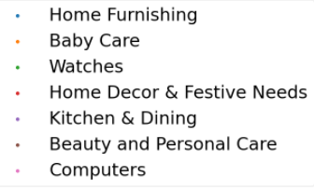
Dimensionality reduction
Principal Components Analysis (PCA) t-SNE
APPLIED on:
CounterVectorizer
HashingVectorizer
Tf-idf Vectorizer
90% of the variance explained by N components
2D PCA Visualization
2D t-SNE Visualization

Slide 11
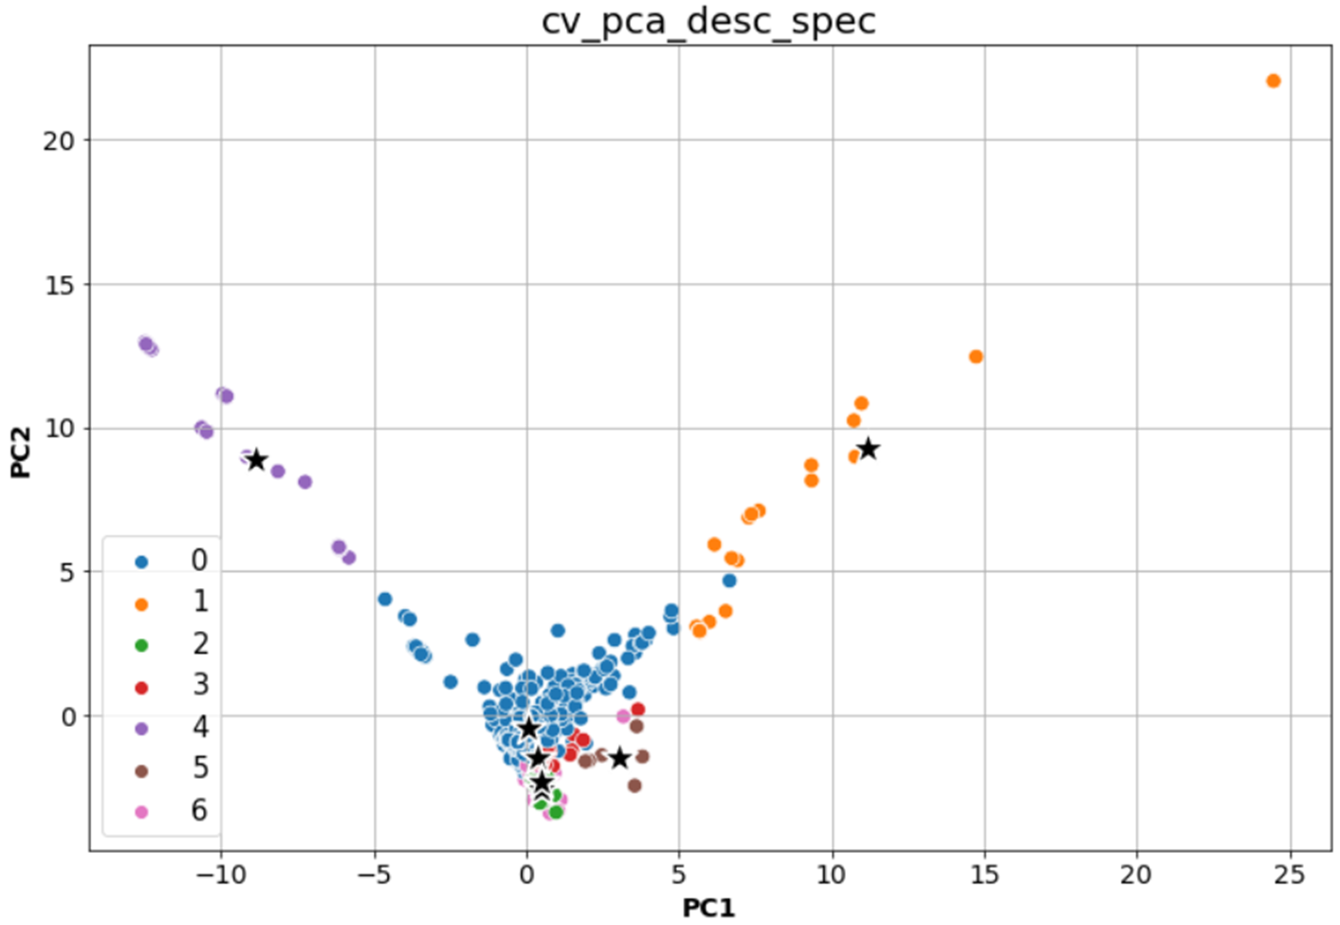
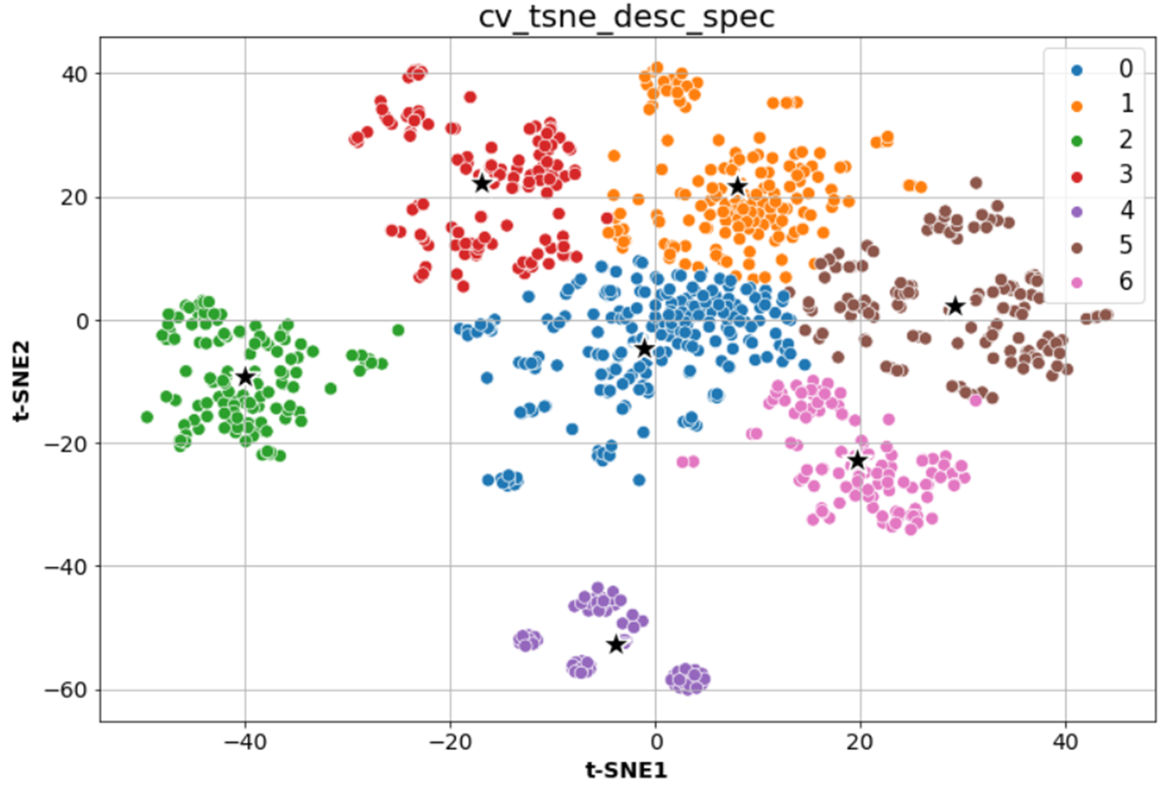
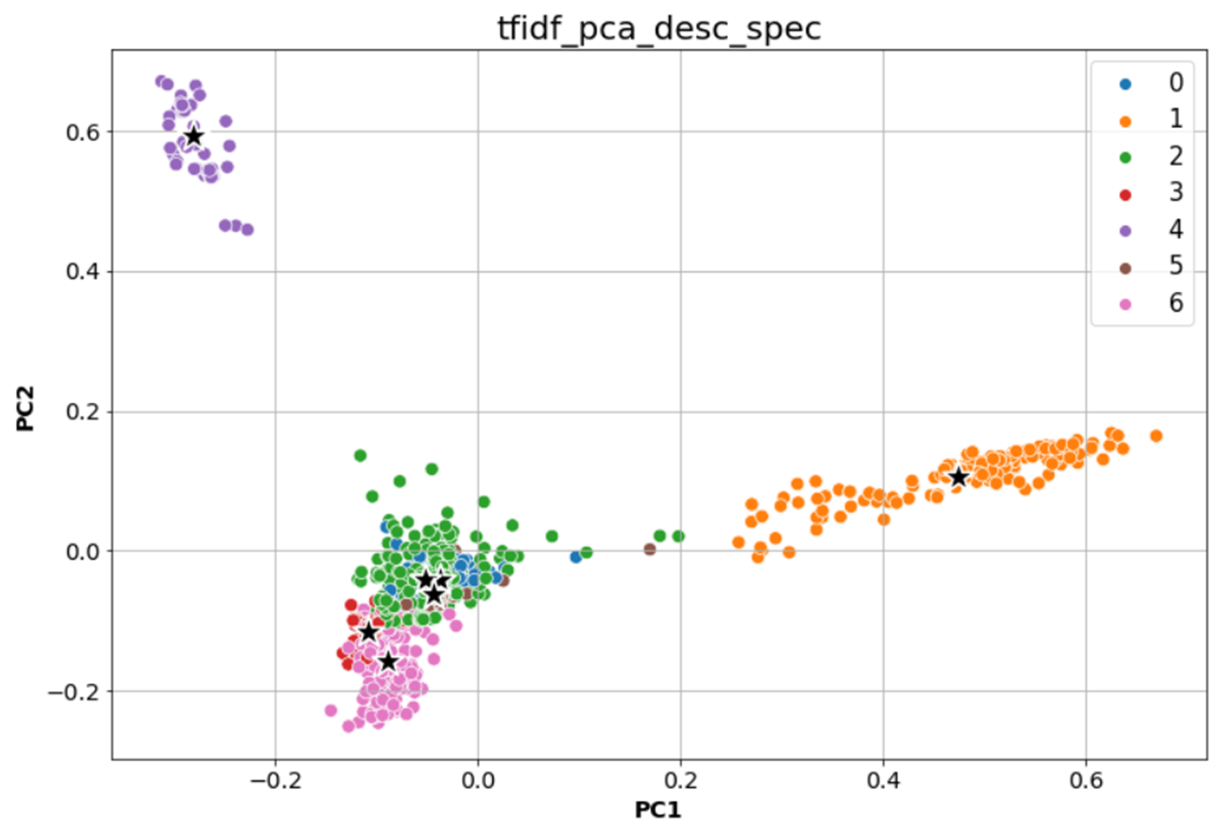
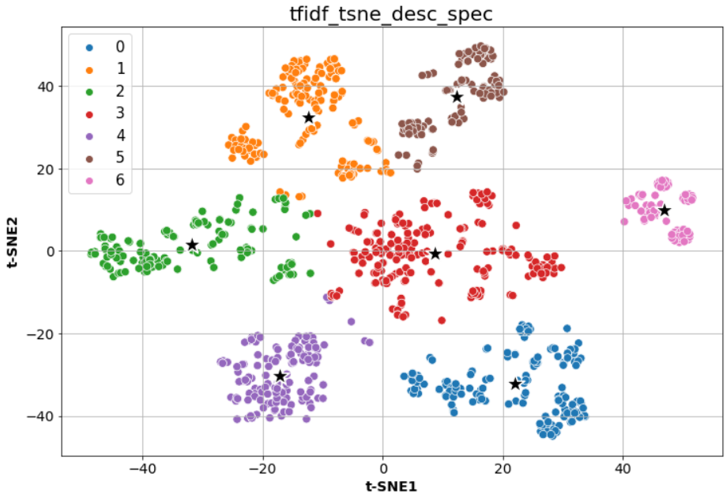
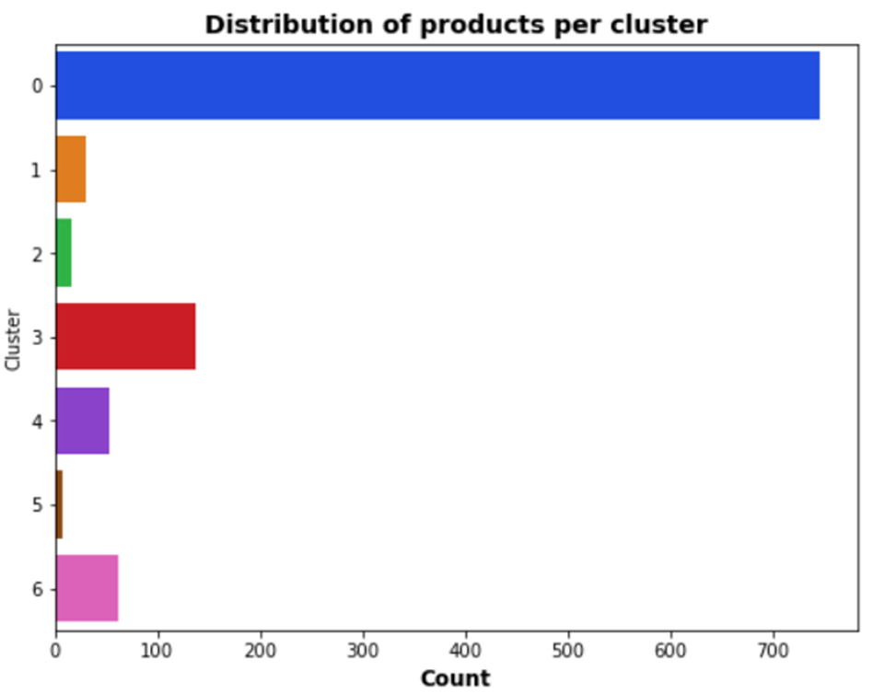
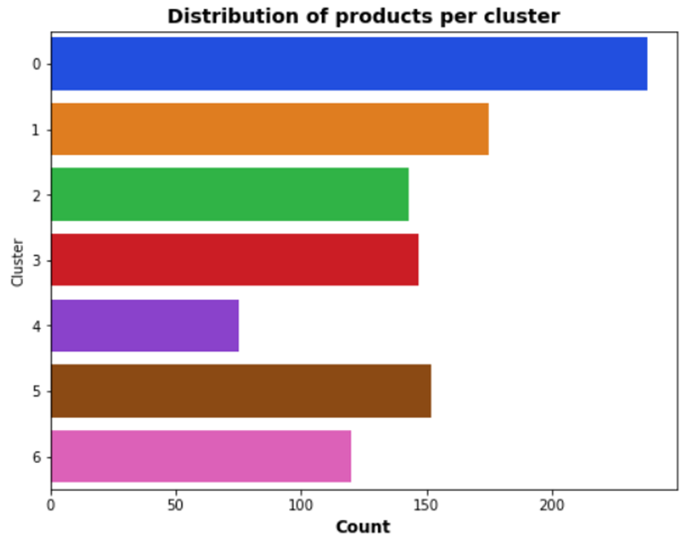
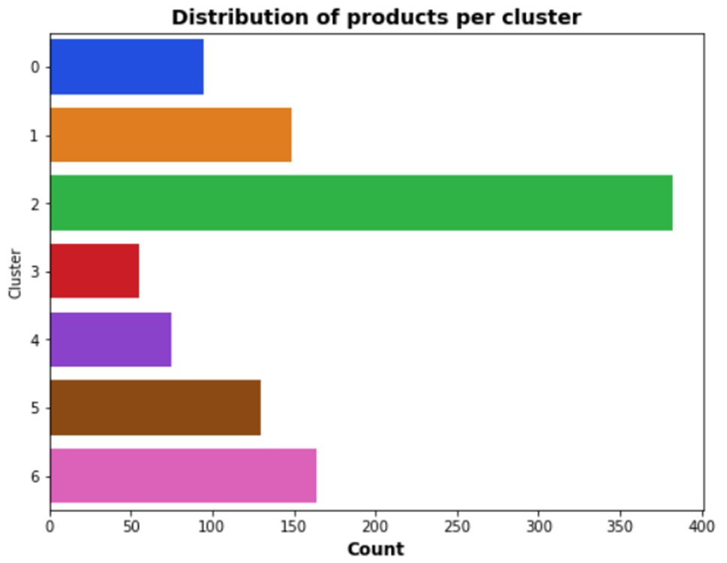
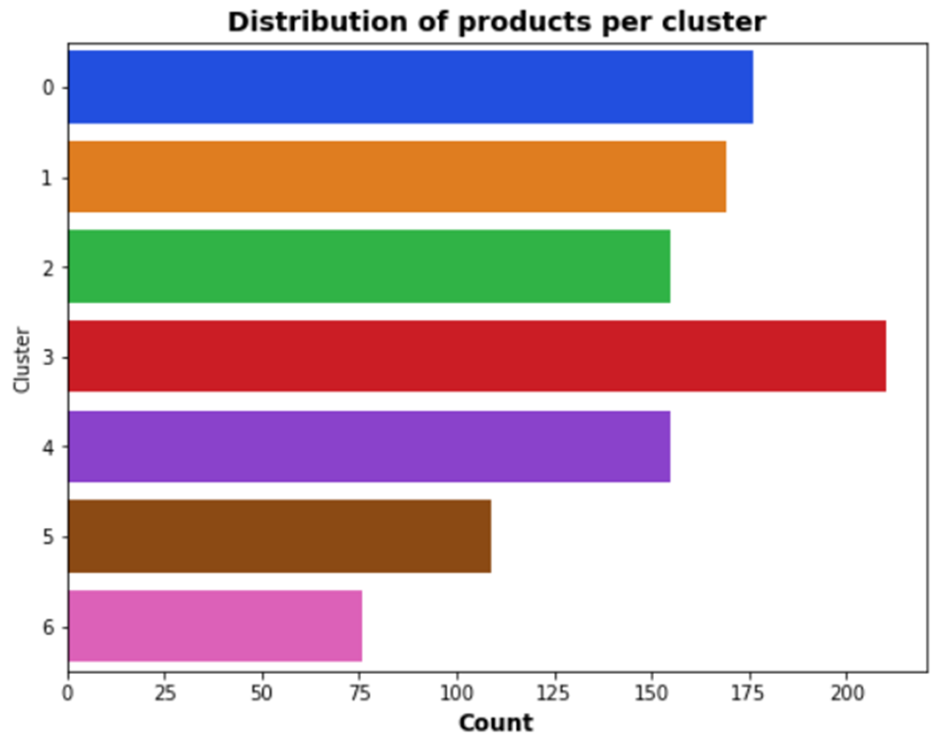
Kmeans clustering – Classic Models
CountVectorizer
Tf-idfVectorizer
PCA
T-SNE
PCA
T-SNE
Computers
Home Furnishing
Watches
Home Decor
Beauty
Kitchen
Baby Care
ARI = 0.13
ARI = 0.55
ARI = 0.44
ARI = 0.62

Slide 12
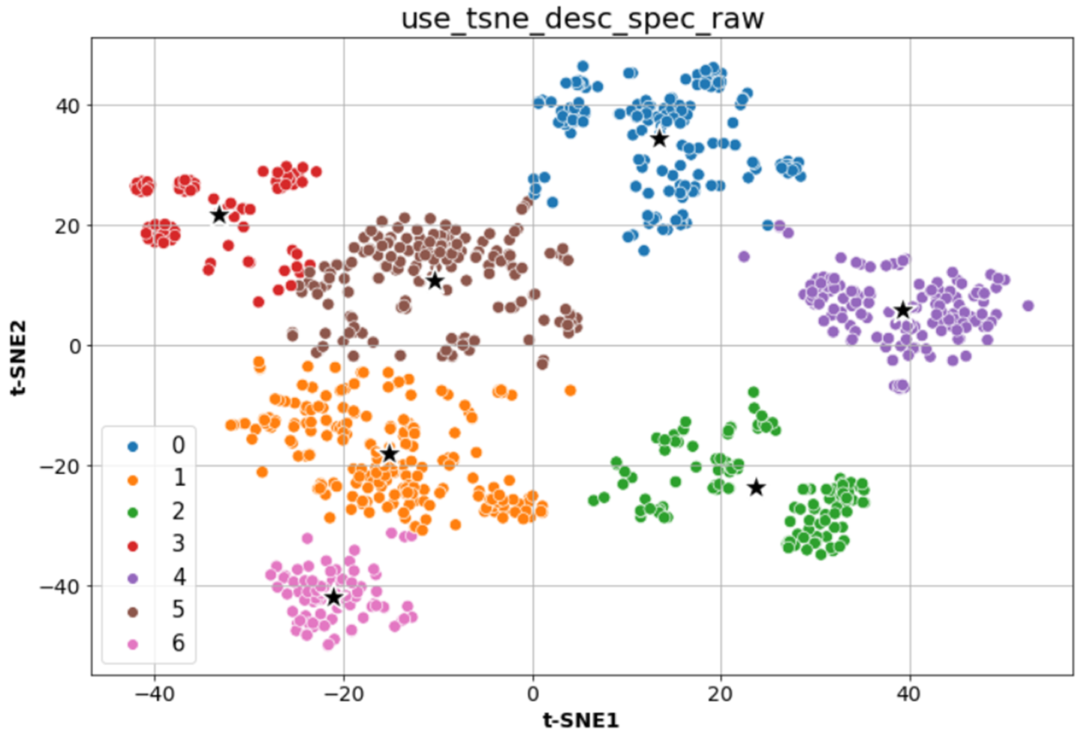
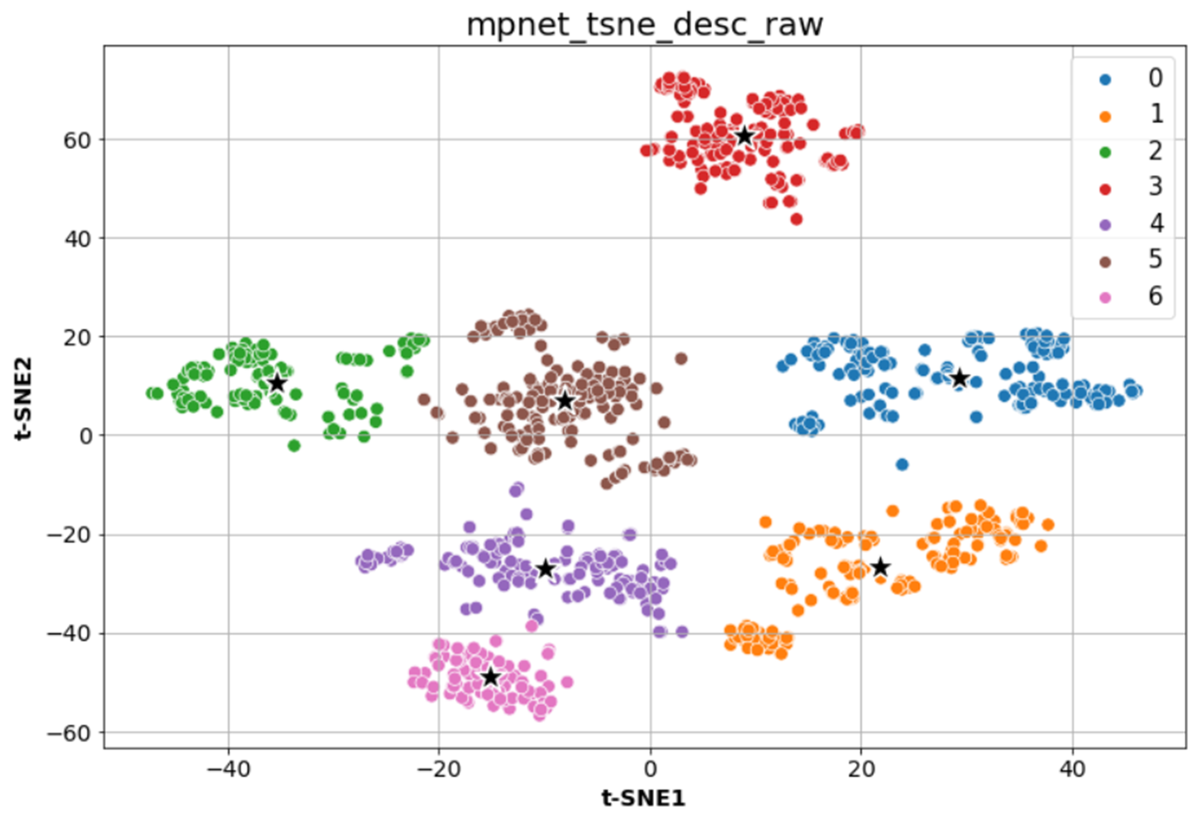
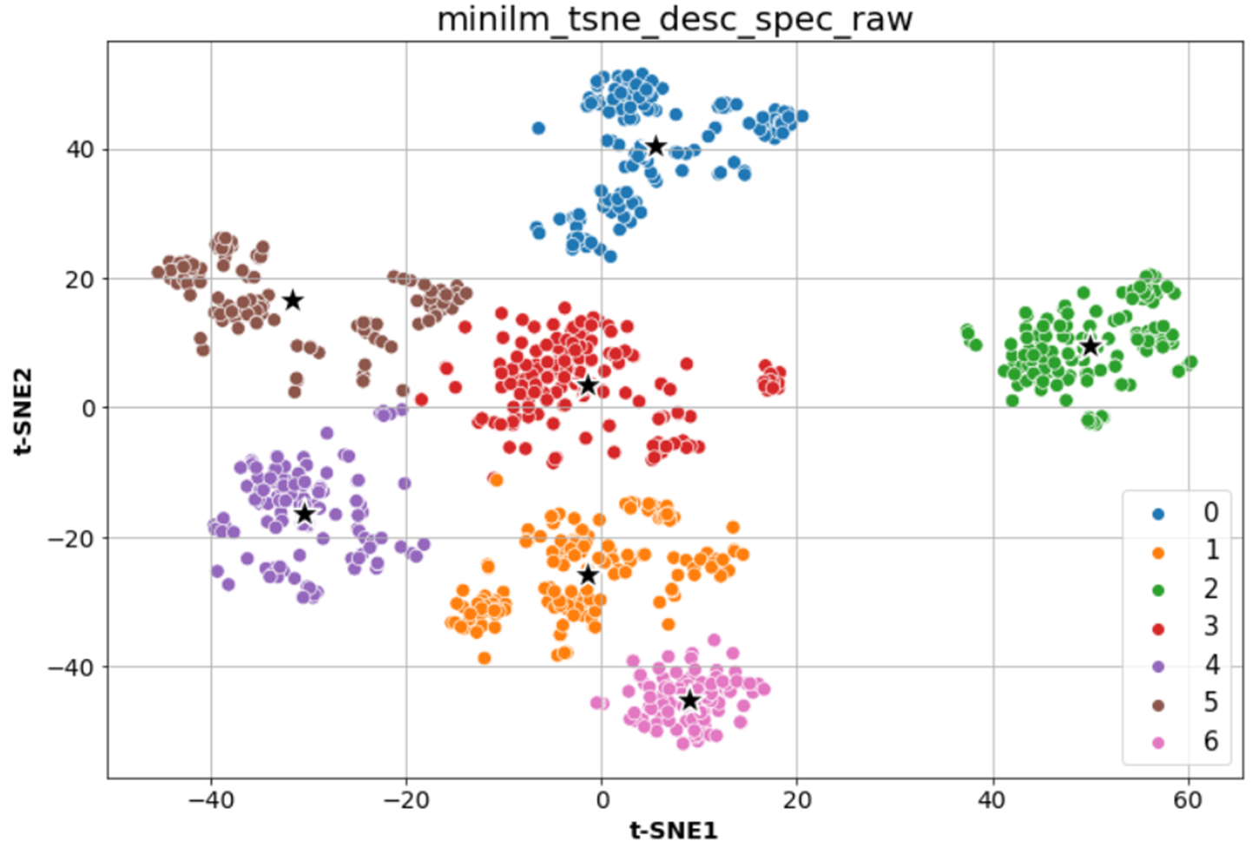
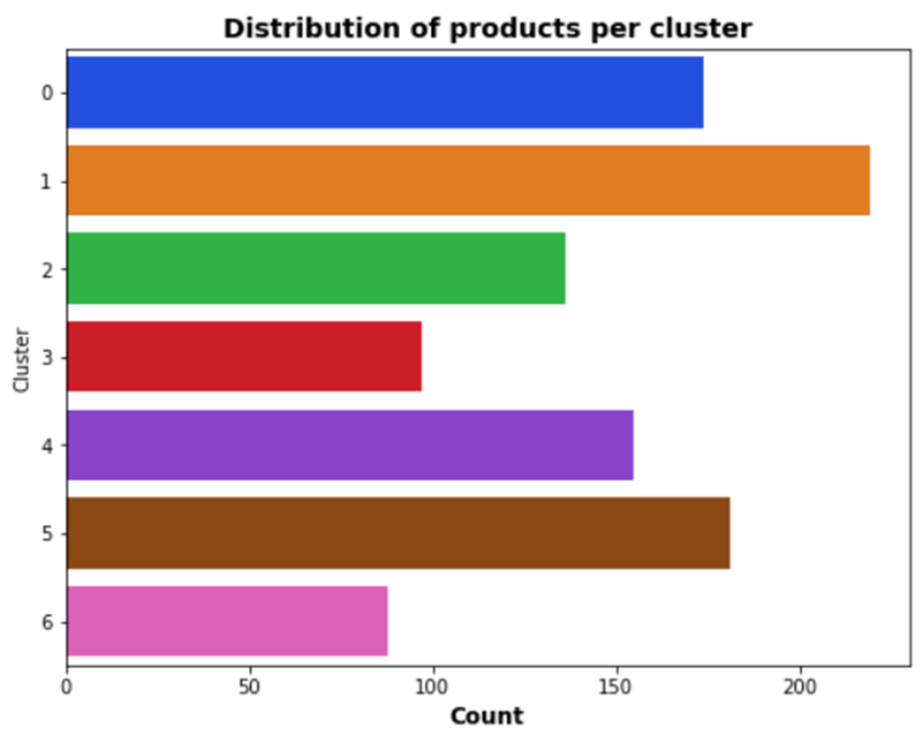
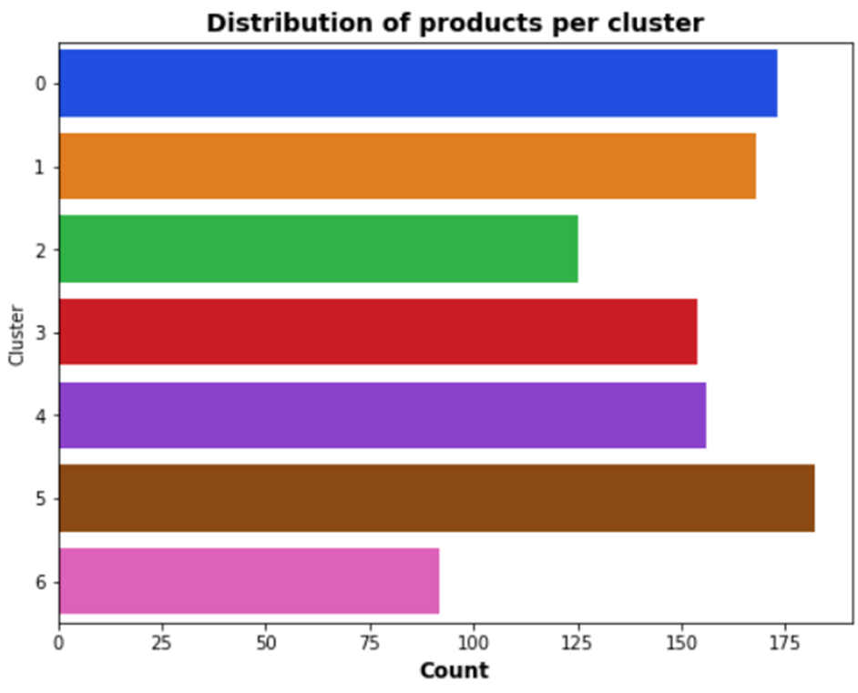
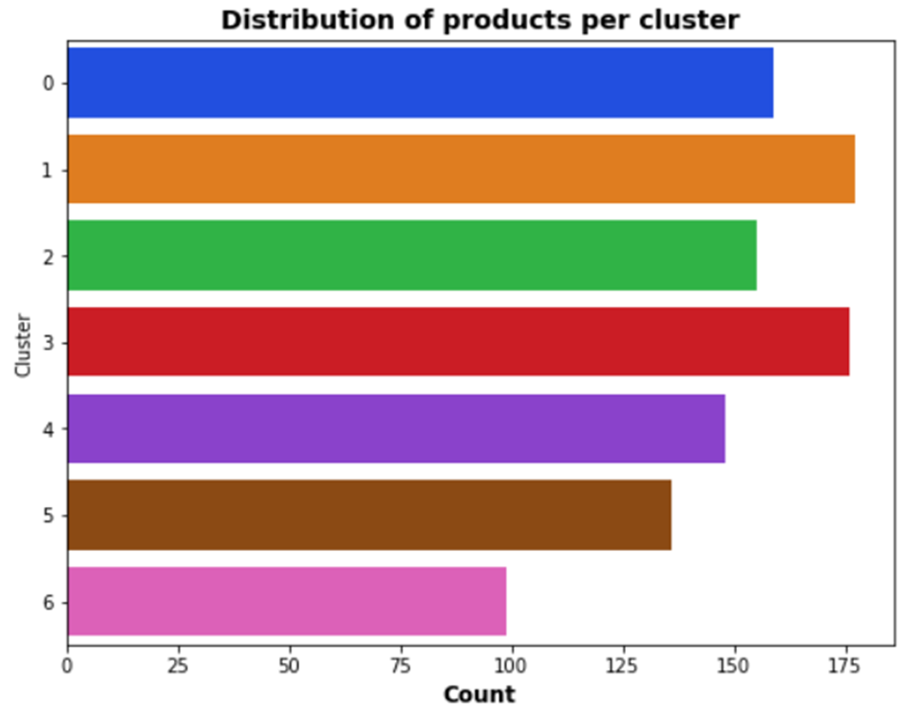
Kmeans clustering – Pre-trained models
USE
MPNet
MiniLM
Computers
Home Furnishing
Watches
Home Decor
Beauty
Kitchen
Baby Care
ARI = 0.66
ARI = 0.71
ARI = 0.71

Slide 13
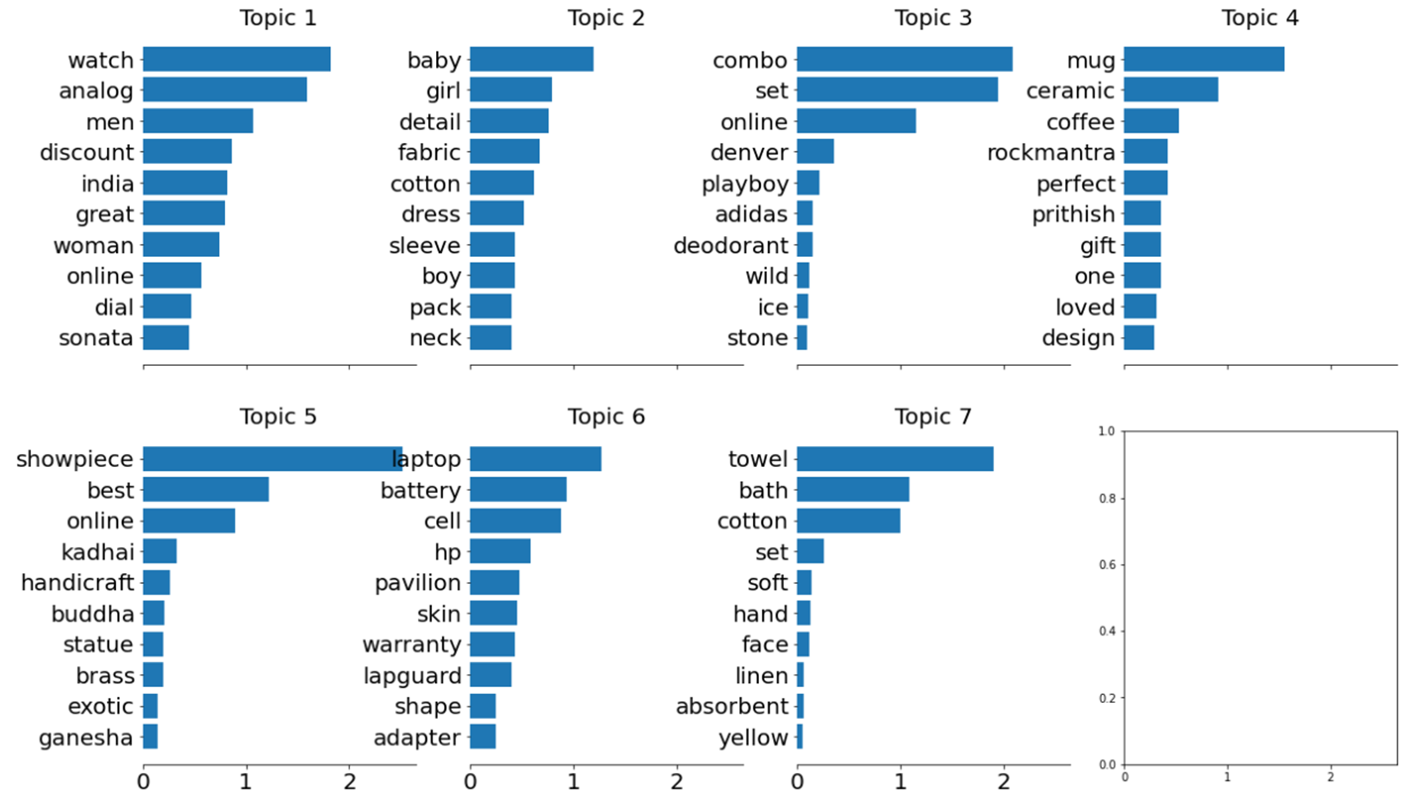
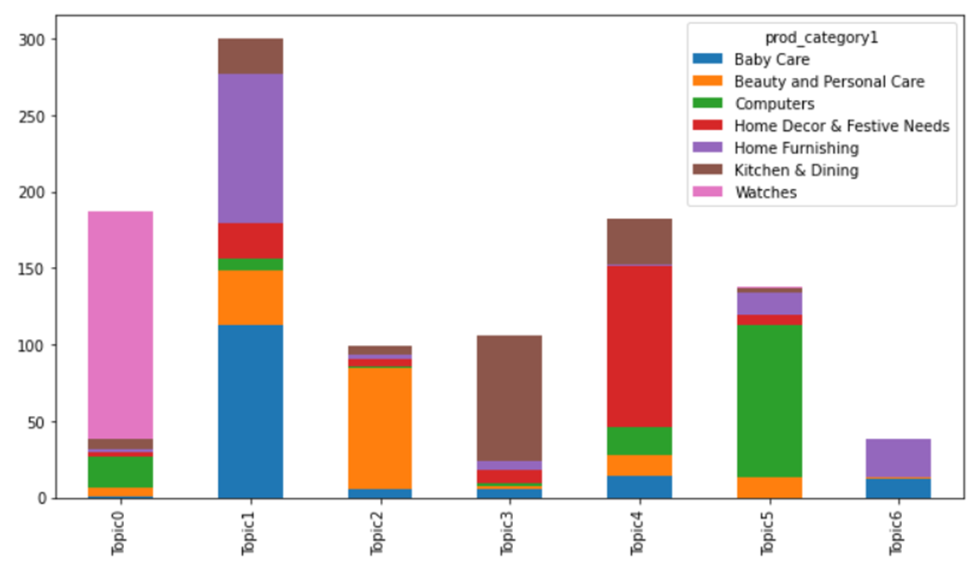
Latent Dirichlet Allocation (LDA) & Non-Negative Matrix Factorization (NMF)
Topics modeling
Top words per topic – NMF tf-idf Vectorizer « description » section
Words from categories assigned to a topic
Watches
Baby Care
Beauty
Kitchen
Words count
Computers
Home Furnishing
Home Decor
Decomposes a document-word matrix into a document-topic and topic-word matrix
Words
NMF or LDA (Develops and fits best topics)
Topics

Slide 14
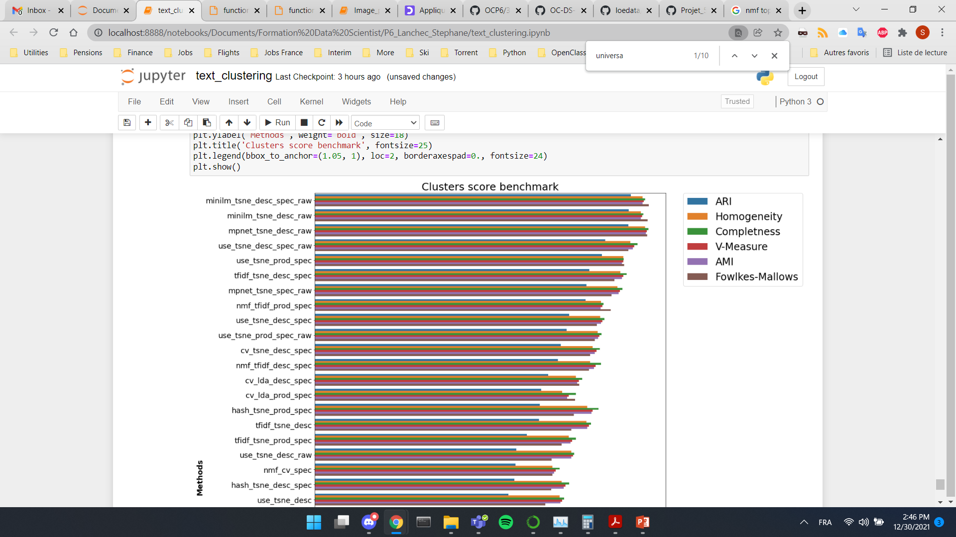
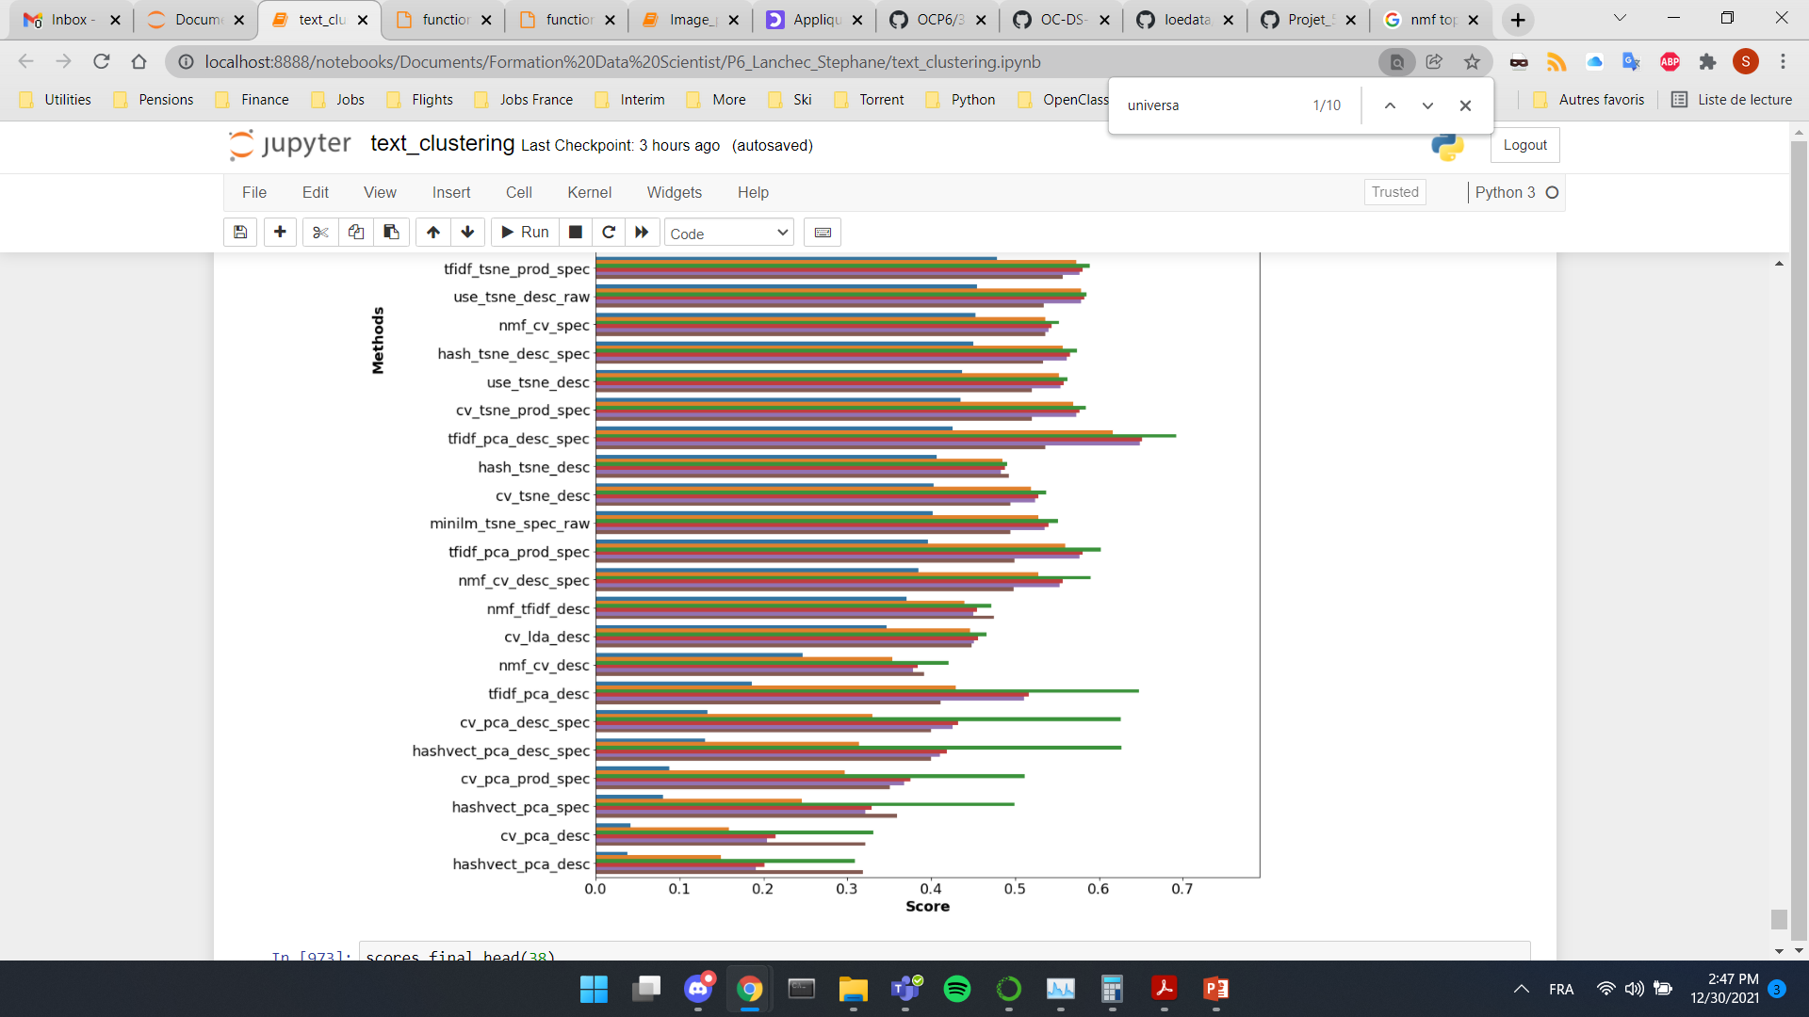
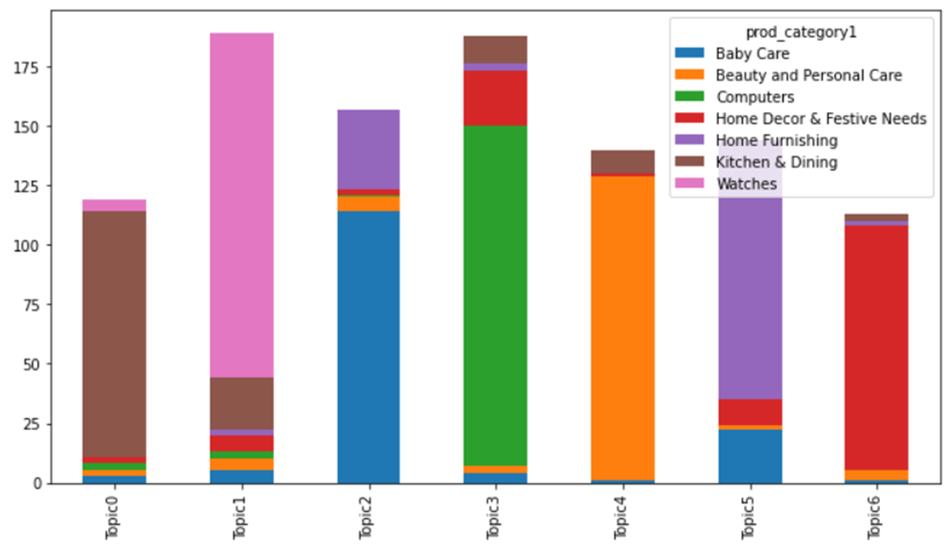
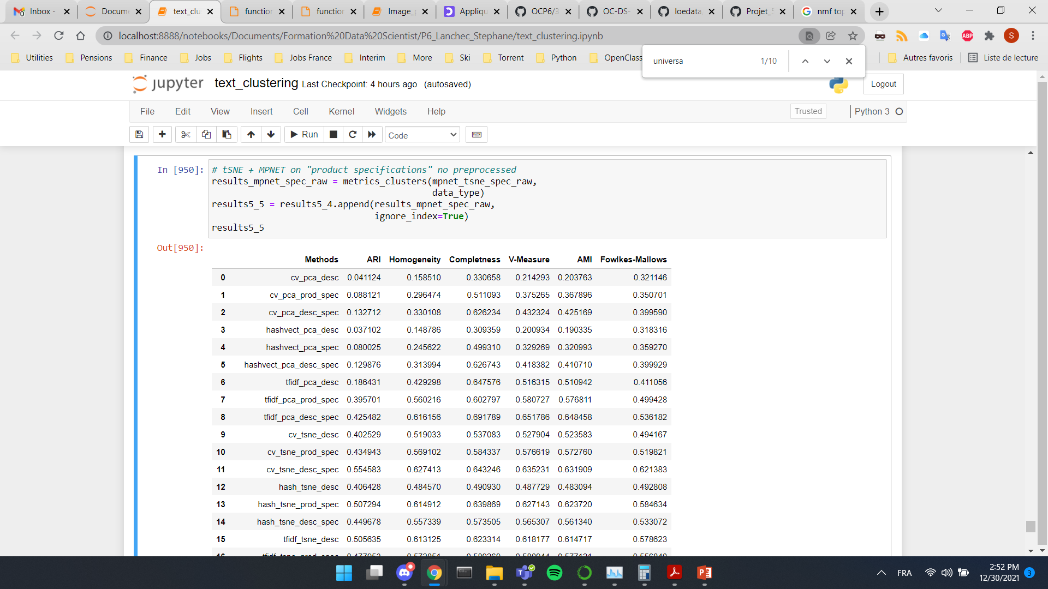
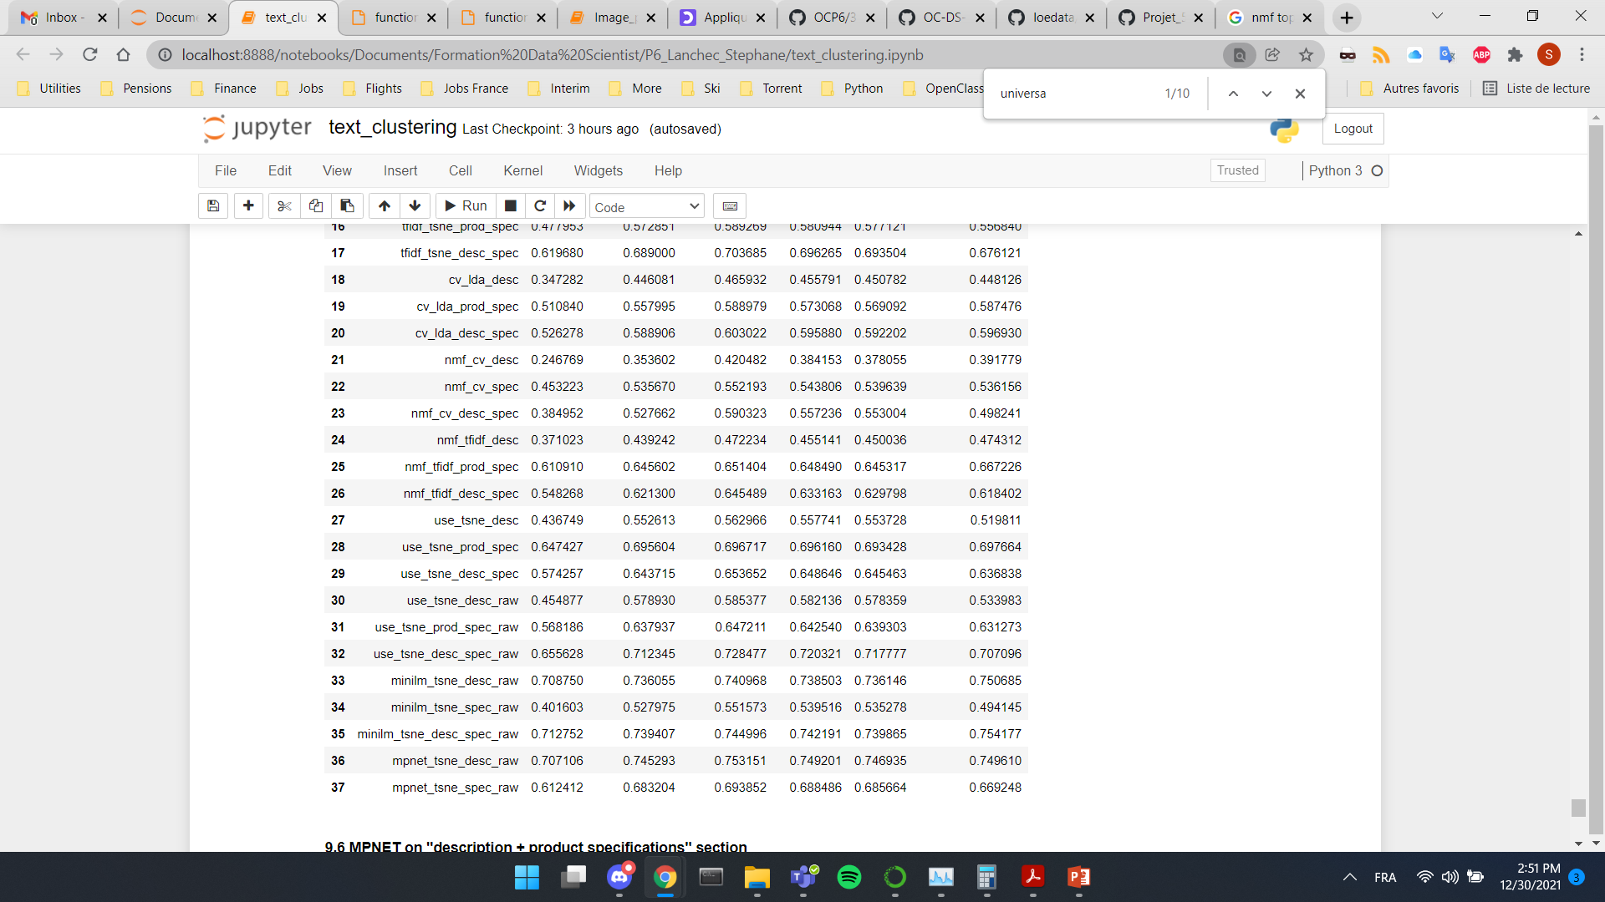
Metrics score
5 best and worst models
Metrics
Topic modeling
ARI
NMF_cv_desc: 0.24
NMF_tfidf_prod_spec: 0.61
Sorted by ARI score
Best model
Worst model

Slide 15
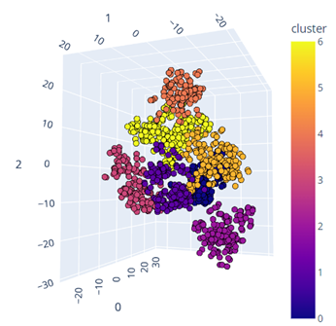
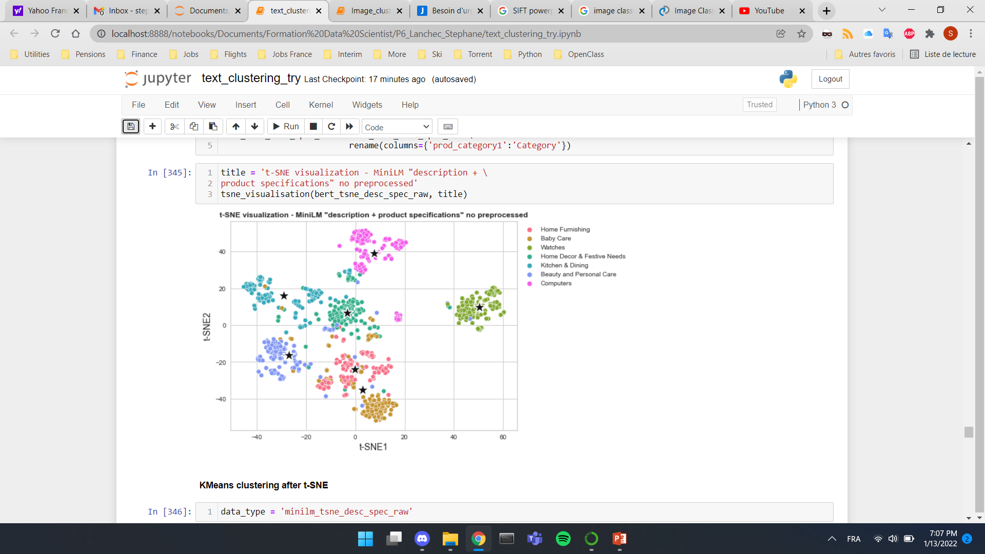
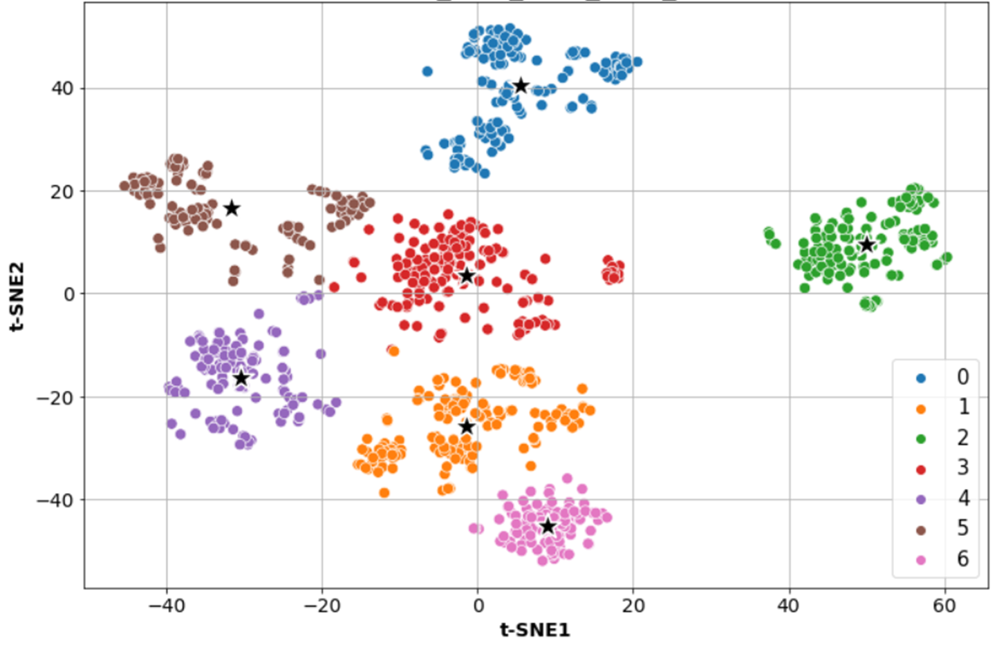
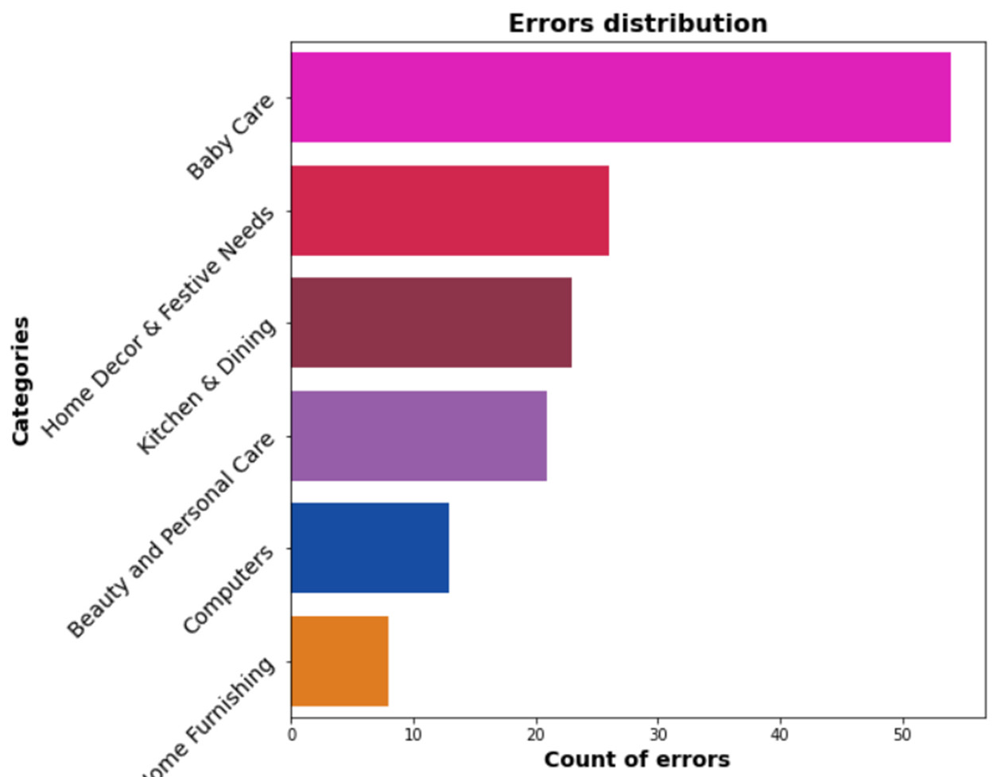
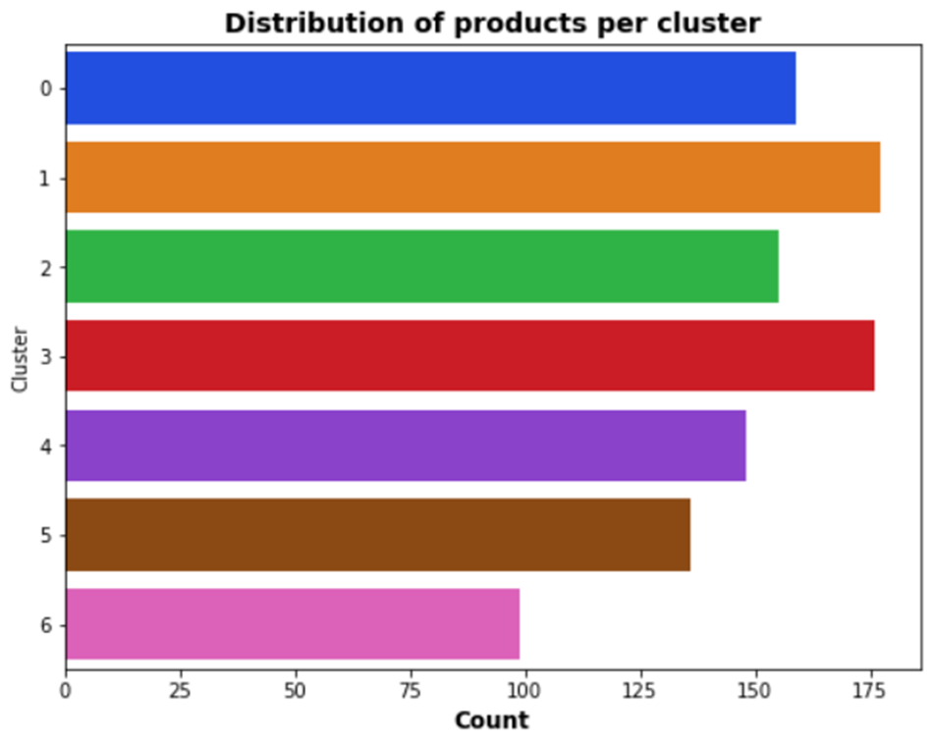
Best model visualization
3D Visualization
MiniLM + tSNE + « description & specifications »
Number of products per category not asssigned to the right cluster
Pre-clustering
Post-clustering
Computers
Home Furnishing
Watches
Home Decor
145 errors
Beauty
Best model
Kitchen
Baby Care
Categories to classify:
Watches – Easiest
Baby Care - Most difficult
ARI = 0.71

Slide 16
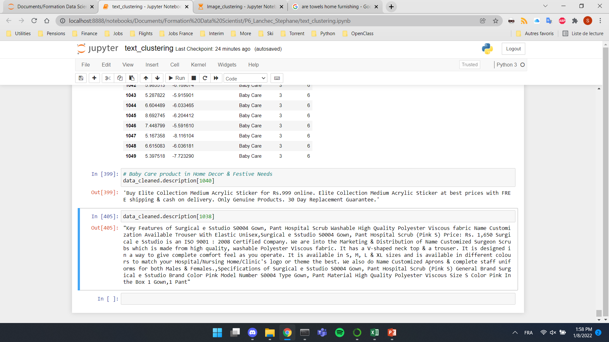
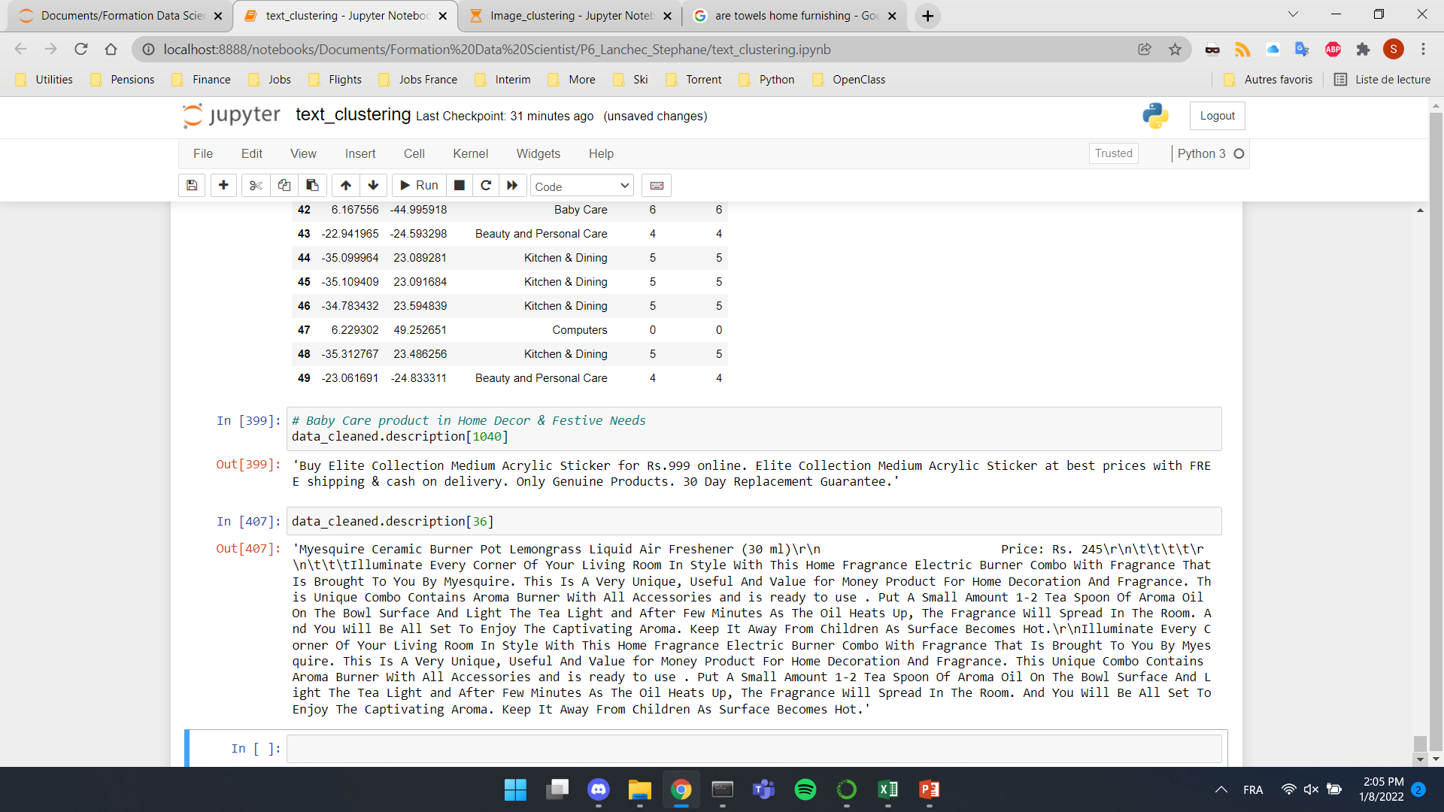
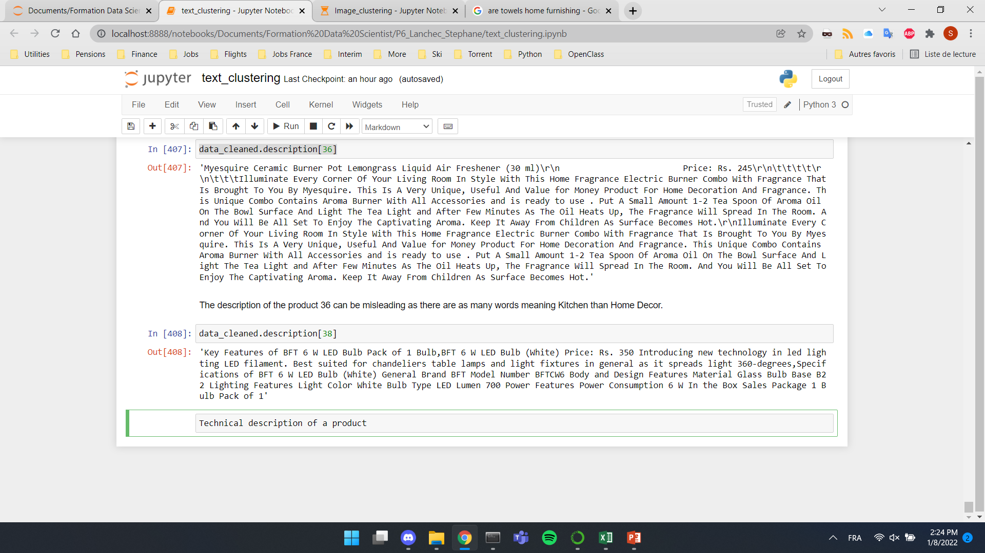
Errors Analysis
Exemples of product wrongly assigned
Category
Cluster
Description
Elite Collection Medium Acrylic Sticker
Product 1040
Baby Care
Home Decor
No information related to baby
Myesquire Ceramic Burner Pot Lemongrass Liquid Air Freshener
Product 36
Home Decor
Kitchen
As many keywords belonging to Kitchen as to Home Decor
BFT 6 W LED Bulb
Product 38
Kitchen
Computers
Too much technical description can be misleading
Could have also been clustered in Home Furniture

Slide 17
Image Process overview
Phase 1
Phase 2
Phase 3
Data Preparation
Pre-processing
Computer Vision
SIFT
Detect, describe, and match local features in images
CNN
VGG16
InceptionV3
Dimensionality reduction
T-SNE
Clustering
KMeans
Model Evaluation
Clusters distribution
Adapted metrics
Methods comparison
Image
RAW
17

Slide 18
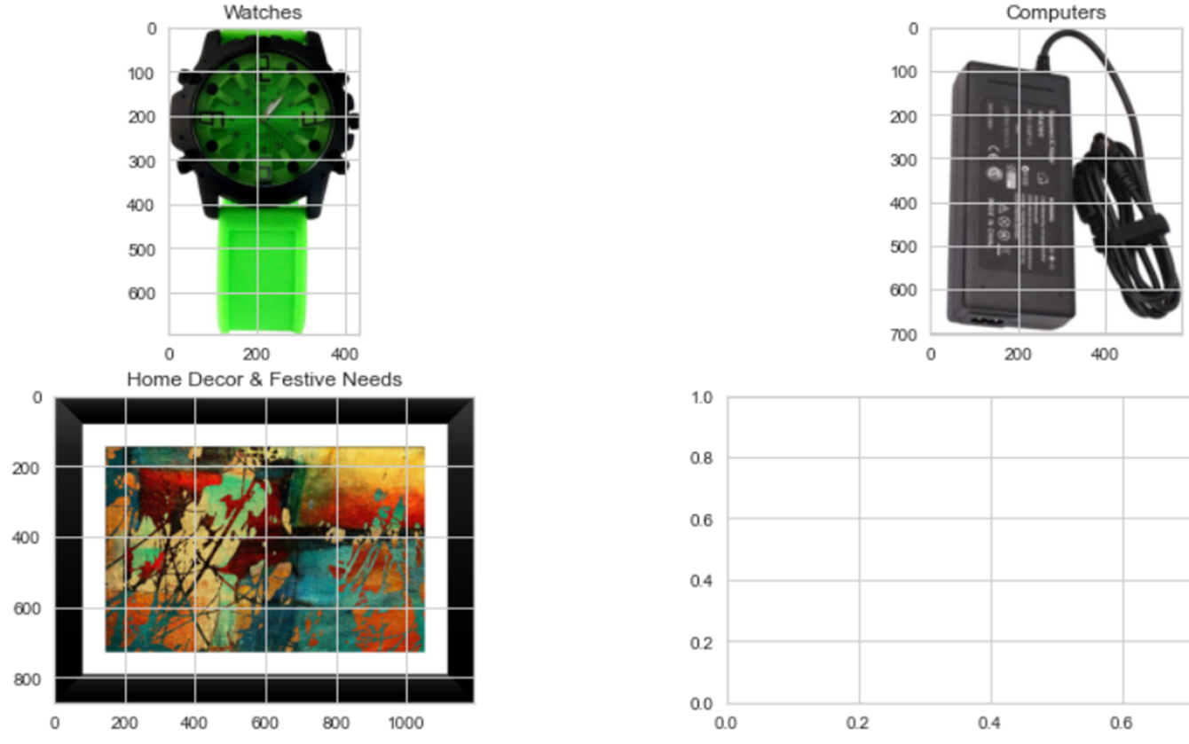
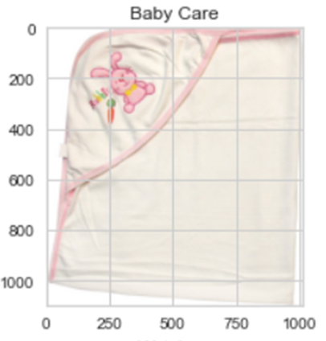





Focus on images
150 images in each of the 7 main categories: Exemples
Dimension distribution of images
Number of images
Width (px)
Height (px)
Size (px)

Slide 19





SIFT (Scale-Invariant Feature Transform)
Input Image
SIFT Keypoints
SIFT descriptors
vocabulary
Descriptor = 128x1 vector assigned to every keypoint/feature
Images pre-processing
Features extraction
Detection
Description - orientation assignment
250k descriptors for all images
Bag of Visual words
Histogram
BOVW & histogram creation
Optimal number of clusters: 1000
Appearance frequency of each visual word
similar key descriptors are clustered with the k-means
All features

Slide 20






Image pre-processing for SIFT
Image test
Adaptative Histogram Equalization (CLAHE) - enhance the local contrast of an image
Grayscale conversion - SIFT operates on grayscale images only
Noise reduction – fastNlMeansDenoising - Perform image denoising
Histogram stretching – correct brightness by `stretching' the range of intensity values
Redimensioning 224*224 (no distorsion)

Slide 21



SIFT - Kmeans clustering
Pre-clustering
Post-clustering
Classification of images through SIFT is not feasible
ARI = 0.0008

Slide 22


Convolutional Neural Network (CNN)
VGG16
InceptionV3
Enable classification on ImageNet
13 convolution layers + 3 fully connected
Pre-trained on ImageNet (>1M images)
1000 classes of images
Return probability each class is represented in the image
48 layers-deep
Pre-trained on ImageNet (>1M images)
Factorization into Smaller Convolutions
Spatial Factorization into Asymmetric Convolutions
Utility of Auxiliary Classifiers

Slide 23







CNN - Kmeans clustering
VGG16
InceptionV3
ARI = 0.32
ARI = 0.45
Watches
Baby Care
Kitchen
Pre-clustering
Pre-clustering
Computers
Home Furnishing
Beauty
Home Decor
Post-clustering
Post-clustering

Slide 24


Errors Analysis for Images classification
Algorithm failed to recognize (ambiguous items)
Total number of errors: 320
Seller’s wrong assignment

Slide 25
Conclusion
As for now:
feasibility of a classification engine with text: POSSIBLE (Best ARI: 0.71 with Minilm on description + prod specifications)
Feasibility of a classification with images: NOT POSSIBLE (Best ARI: 0.45 with InceptionV3)
Focus on Transformer-based Sentence and CNN algorithms for best results
Better description of some products could lead to better classification in text
Careful initial categorization of images by the seller is strongly recommended
Going further
Test of other CNN models
Models optimization through GridsearchCv
Update with higher number of items
Comparison with supervised classification

